Slide 1


Alalade Oluwaferanmi, O
24th August, 2022

Slide 2

Outline
Executive Summary
Introduction
Methodology
Results
Conclusion

Slide 3
Executive Summary
Summary of methodologies
Data about Falcon 9 launches was acquired from public sources – SpaceX data site and Wikipedia;
Research was performed primarily with Python libraries for data acquisition, wrangling, visualization and modelling
Correlations between various parameters (time, site, orbit, payload) and landing success were studied, 4 models were built and tested;
Summary of all results
Models built show predictive accuracy for landings outcome between 83 and 95 percent, which rather high. The highest score produced Decision Tree model; •
There are major correlations between:
time (failures become rarer),
orbit (launches to low orbits have higher landing success rate),
payload (high-loaded launches are more successful in landings, though it may derive from orbits correlation)

Slide 4
Introduction
The Falcon 9 is a vehicle that can carry cargo and humans into Space. The rocket has two stages.
The Booster Stage: Which carries the second stage to a certain altitude, which then returns to the earth surface, either on Drone ships, Ground pads, to facilitate reuse.
The second Stage: which carries the cargo to the destination.
This project is to predict the Falcon 9 landing, if the first stage will land successfully or not using Machine Learning algorithms.

Slide 5

Section 1

Slide 6
Methodology
Executive Summary
Data collection methodology:
SpaceX website: https://docs.spacexdata.com/
Wikipedia: List of Falcon 9 and Falcon Heavy launches - Wikipedia
Perform data wrangling
Replacement of missing values
Representation of landing outcomes as binary
Perform exploratory data analysis (EDA) using visualization and SQL
Perform interactive visual analytics using Folium and Plotly Dash
Perform predictive analysis using classification models
Using Grid Search to find the best parameters for each model

Slide 7
Data Collection
The data used in this project was gotten from the SpaceX website itself and Wikipedia. Additional information was gotten from Wikipedia also for the description and full forms of abbreviations

Slide 8
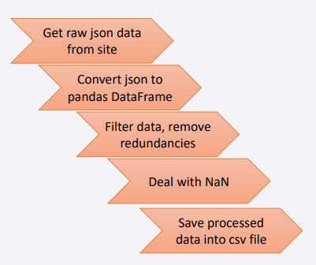
Data Collection – SpaceX API
The data was collected using REST APIs from the spacexdata API using requests.
https://docs.spacexdata.com/
It was then turned to a DataFrame using json_normalize. The resulting DataFrame consisted of 43 columns which was then narrowed down into six which were Rocket, Payloads, Launchpad, Cores, flightnumber, date_utc. These columns were then used to get additional information using predefined functions. The final DataFrame called df consisted of 17 columns namely FlightNumber, Date, BoosterVersion, PayloadMass, Orbit, LaunchSite, Outcome, Flights, GridFins, Reused, Legs, LandingPad, Block, ReusedCount, Serial, Longitude and Latitude.
The DataFrame df was then filtered to contain only the ‘Falcon 9’ rockets in the BoosterVersion column.
https://github.com/Feranmi-Alalade/IBM-Data-Science-Capstone-SpaceX/blob/main/1_Data_Collection.ipynb

Slide 9
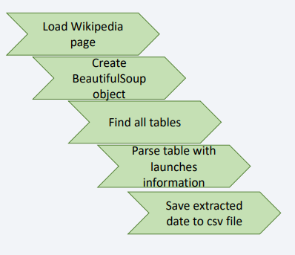
Data Collection - Scraping
The Wikipedia was first loaded and the request method was used.
A beautiful soup object was created and using the find_all() method, all tables were found using the keyword “Table”, the information in each table was then parsed into a dictionary by using the same find_all() method using “th” and “tr”.
The data was then extracted into a csv file
https://github.com/Feranmi-Alalade/IBM-Data-Science-Capstone-SpaceX/blob/main/2_Webscraping.ipynb

Slide 10
Data Wrangling
Acquired data was processed with Pandas library
To determine initial patterns following values were calculated:
number of launches by site;
number of occurrence of each orbit;
number of different landing outcomes;
To enable further analysis landing outcomes were categorized into 0 (failure) and 1 (success) values
https://github.com/Feranmi-Alalade/IBM-Data-Science-Capstone-SpaceX/blob/main/3_Data_Wrangling.ipynb

Slide 11
EDA with Data Visualization
Different charts were plotted to make inferences during EDA
Scatter point charts were plotted to view the relationship between:
‘FlightNumber and Launch Site’,
Payload mass and Launch site: It was observed that for the VAFB-SLC launchsites, there are no launches for payload mass greater than 10000kg.
FlightNumber and Orbit
A barplot to show the success rate for each each orbit
A line chart to show the launch success trend yearly
https://github.com/Feranmi-Alalade/IBM-Data-Science-Capstone-SpaceX/blob/main/5_EDA_Viz_lab.ipynb

Slide 12
EDA with SQL
SQL Queries used during the Project:
Using DISTINCT( ) to select the unique launch sites in the space mission.
Select distinct(launch_site) from soacextbl
To display 5 records where launch sites being with ‘CCA’
Select * from spacextbl where launch_site like ‘CCA%’ LIMIT 5
Display the total payload mass carried by boosters launches by NASA (CRS)
Select customer, sum(payload_mass__kg) as sum fromspacextbl
where customer like ‘NASA (CRS)’
group by customer
Display average payload mass carried by booster version F9 v1.1
select avg(payload_mass__kg_) from spacextbl where booster_version = 'F9 v1.1'

Slide 13
EDA with SQL
SQL Queries used during the Project:
List the date when the first successful landing outcome in ground pad was acheived.
select date from spacextbl where landing_outcome like 'Success (ground pad)%' and date = (select min(date) from spacextbl)
List the names of the boosters which have success in drone ship and have payload mass greater than 4000 but less than 6000
select booster_version from spacextbl where payload_mass__kg_ between 4000 and 6000 and landing_outcome like 'Success%drone'
https://github.com/Feranmi-Alalade/IBM-Data-Science-Capstone-SpaceX/blob/main/EDA_SQL.ipynb

Slide 14
Build an Interactive Map with Folium
Interactive Map Stages
The Launch Sites were first located on the map using markers (to mark the different coordinates on the map).
The different launches from each launch site were then clustered together (using MarkerCluster) to identify them as one, and an icon was added to label the launches that were successful (Green) and unsuccessful (Red).
Polylines were used to mark the distances from the launch sites to the nearest coastline, city and railway line.
Images are shown in the next slide.
https://github.com/Feranmi-Alalade/IBM-Data-Science-Capstone-SpaceX

Slide 15
Folium
Markers showing the different Launch Sites

Slide 16
Folium
Marker Clusters showing the different Launch Sites

Slide 17
Folium
Icons showing the success rate

Slide 18
Folium
Polylines showing the distance to the coastline

Slide 19
Predictive Analysis (Classification)
In this project, we predicted the landing outcome of the Falcon 9 first stage using Data Science methodology and Machine Learning algorithms. SpaceX rocket launches costs about 65 million dollars while other providers cost about 165 million upwards. This is because SpaceX reuses its first stage, which is also called the booster stage. The booster returns to the earth surface landing on either ground pads, ocean ships or Drone ships. This project is based on previous launch data (the landing outcomes of the boosters of previous launches), and algorithm predicts the landing outcomes of future launches.
A new binary column ‘Class’ was added to the dataframe, 0 for unsuccessful landing and 1 for successful landing.
Machine Learning algorithms namely Support Vector Machines, K-Nearest Neighbors, Logistic Regression and Decision trees were then trained on the features: Orbit, PayloadMass, Flights, Block, etc.
The algorithms were then used to predict the landing of the rockets

Slide 20
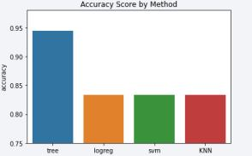
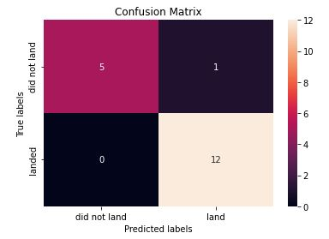
Results
The Decision tree model was the model with the highest accuracy of almost 95%
The confusion matrix is also added in this slide
https://github.com/Feranmi-Alalade/IBM-Data-Science-Capstone-SpaceX/blob/main/7_Machine_learning_Prediction.ipynb

Slide 21

Section 2

Slide 22
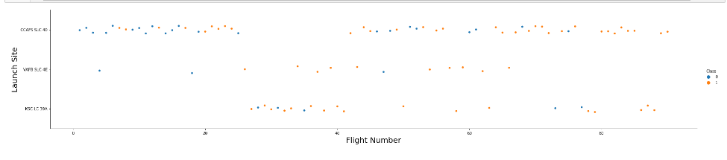
Flight Number vs. Launch Site
We can see in this chart that the earlier launches took place at the CCAFS SLC-40 launch site, we can also see that the CCAFS SLC-40 is the preferred location for launches.

Slide 23
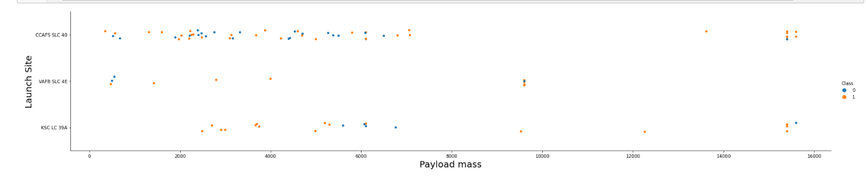
Payload vs. Launch Site
We can see in this chart that launches with payload mass of above 10,000kg do took place at the CCAFS SLC-40 launch site, we can also see that launches with payload mass of less than about 2500kg do not take place at KSC LC 39A launch site.

Slide 24
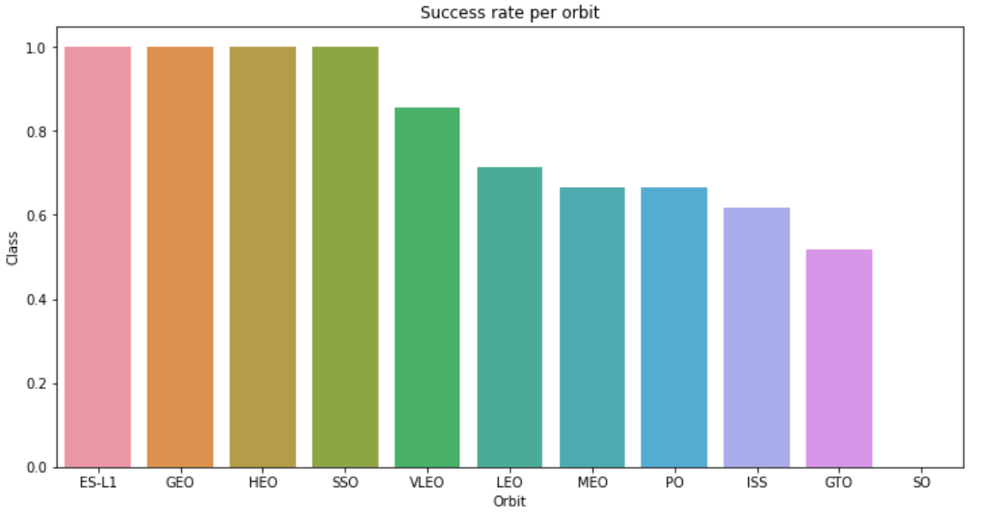
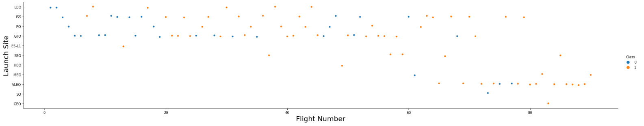
Success Rate vs. Orbit Type
Launches to GTO orbit are clear underdogs with lowest success rate (among orbits with at least 3 missions) with visually small gain over time. This a high geosynchronous orbit located at 22,236 km above Erth. Contrary to it, low-distance orbits (VLEO, ISS, LEO) show much better results

Slide 25
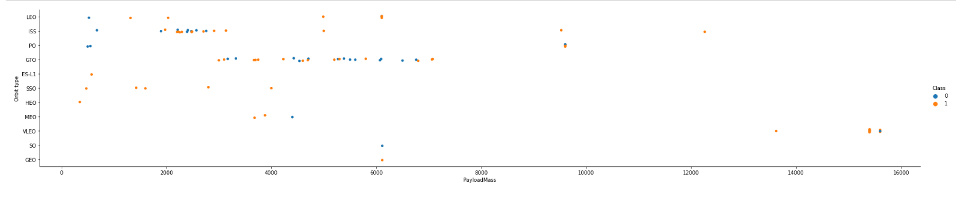
Payload vs. Orbit Type
All of the medium and high payload launches happen to low-Earth orbits (VLEO, ISS, PO), with high success rate. Lower payloads can be observed both at geosynchronous orbits and low-Earth orbits, generally, with significantly lower rate of successful landings.

Slide 26
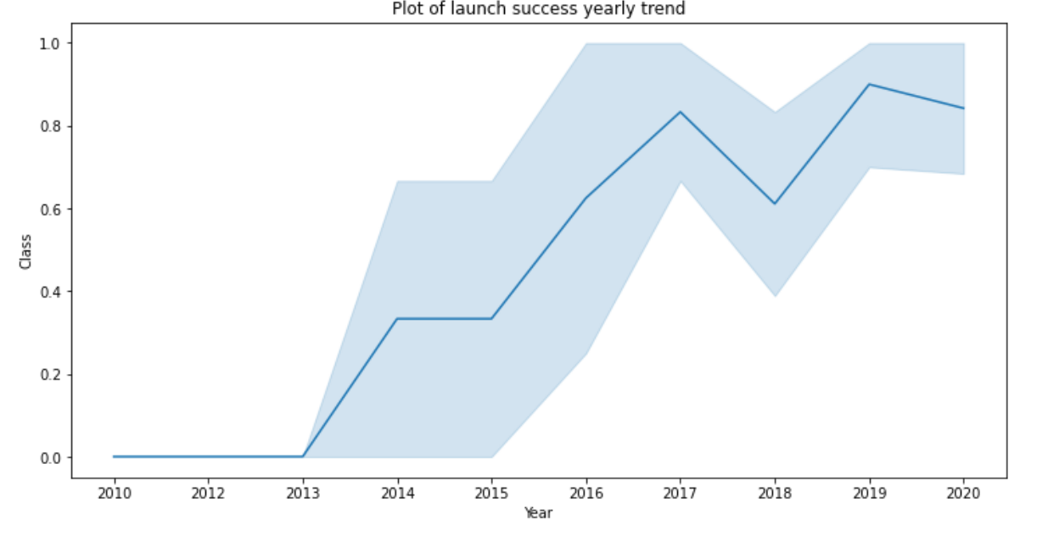
Launch Success Yearly Trend
The Success rate increases yearly due to improved technology and experience.

Slide 27
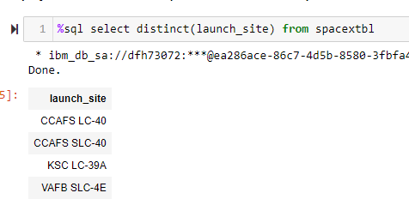
All Launch Site Names
Though 4 sites are present in initial database, actually all launches were performed from 3 sites – CCAFS LC-40 was renamed into CCAFS SLC-40 and means “Cape Canaveral Space Launch Complex”, Florida. Nearby located KSC LC-39A which i.e. “Kennedy Space Center Launch Complex”. VAFB SLC-4E is in California and the full name is “Vandenberg Space Launch Complex”.

Slide 28
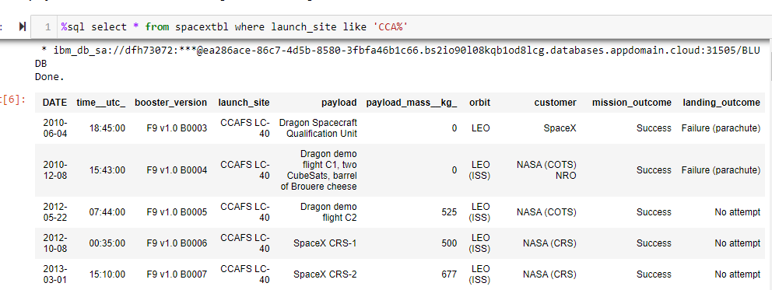
Launch Site Names Begin with 'CCA'
These are the first five launches that took place at launch sites starting with ‘CCA’

Slide 29
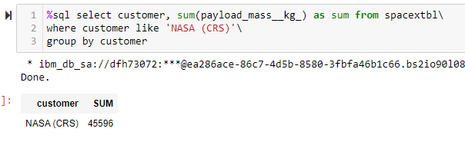
Total Payload Mass
The total payload mass of all launches that belonged to the NASA (CRS) was 45596kg

Slide 30
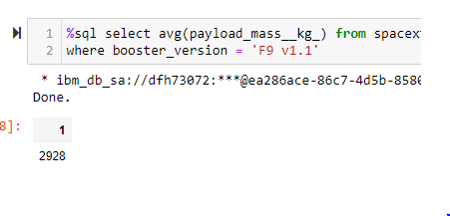
Average Payload Mass by F9 v1.1
The average payload mass of all launches that where the booster version was ‘F9 v1.1’ is 2928kg, which is not very much.

Slide 31
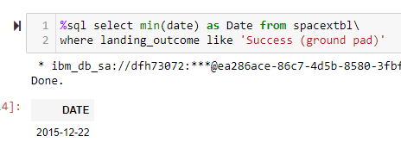
First Successful Ground Landing Date
The date of the first successful ground landing date was 2015 which was five years after the first launch in 2010.

Slide 32
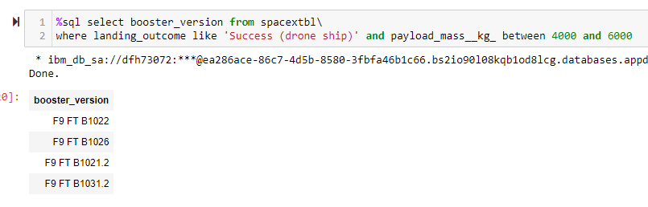
Successful Drone Ship Landing with Payload between 4000 and 6000
This shows the booster version of the successful drone ship landing with payload between 4000 and 6000kg

Slide 33
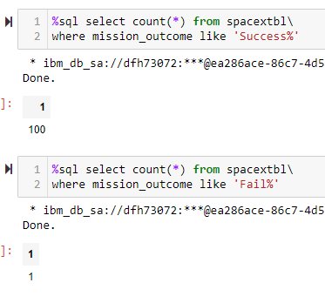
Total Number of Successful and Failure Mission Outcomes
All launches according to Mission outcomes except one were successful

Slide 34
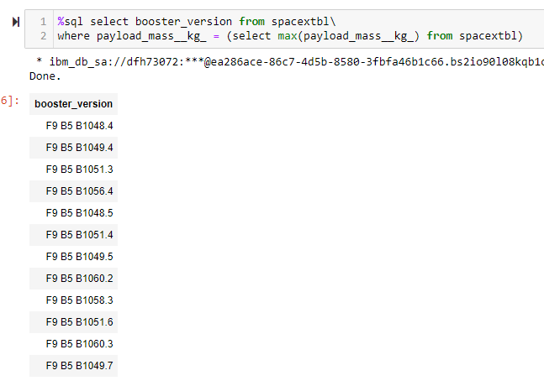
Boosters Carried Maximum Payload
The booster versions where the launches carried the maximum payload mass are listed

Slide 35
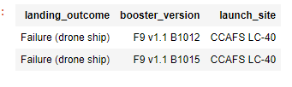
2015 Launch Records
2015 launch records where the booster failed landing on the drone ships

Slide 36

Section 3

Slide 37
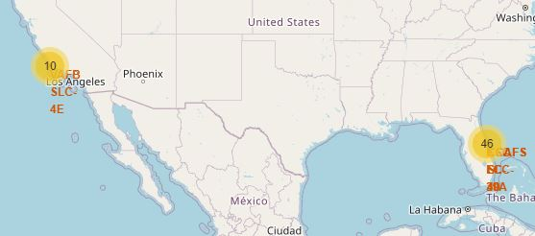
LAUNCH SITE CLUSTERS
The launches took place in two clusters: 10 in California and 46 in Florida

Slide 38
SUCCESS RATES
CCAFS LC-40
CCAFS SLC-40
KSC LC-39A
VAFB SLC-4E
Information about the launch sites can be gotten by clicking on the different clusters. KSC LC-39A has the highest success rate.

Slide 39
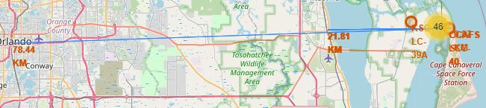
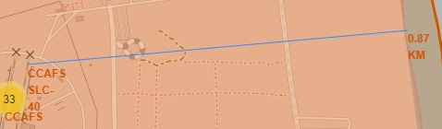
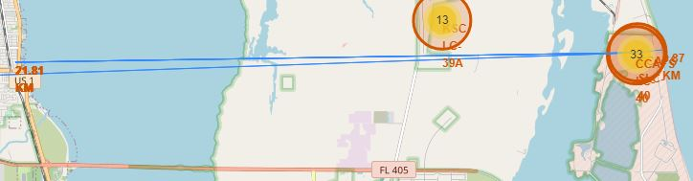
Proximity
The launch sites are closer to the coast line(0.87km) relative to the city(78km) and the rail line(22km)

Slide 40

Section 5

Slide 41
Classification Accuracy
The Decision tree model returned the highest accuracy with an accuracy of 91.4%. The confusion matrix also shows a high True Negative rate and a high True Positive rate

Slide 42
Conclusions
Four different algorithms were trained on the same data, and the Decision tree model was able to predict 12 out of 13 successful landings and 5 out of 5 unsuccessful landings.

Slide 43


